Slide 1
Football Players Movement Analysis in Panning Videos
Karol Działowski and Paweł Forczmański
Faculty of Computer Science and Information Technology, West Pomeranian
University of Technology, Szczecin, Zołnierska Street 49, 71-210 Szczecin, Poland
pforczmanski@wi.zut.edu.pl

Slide 2
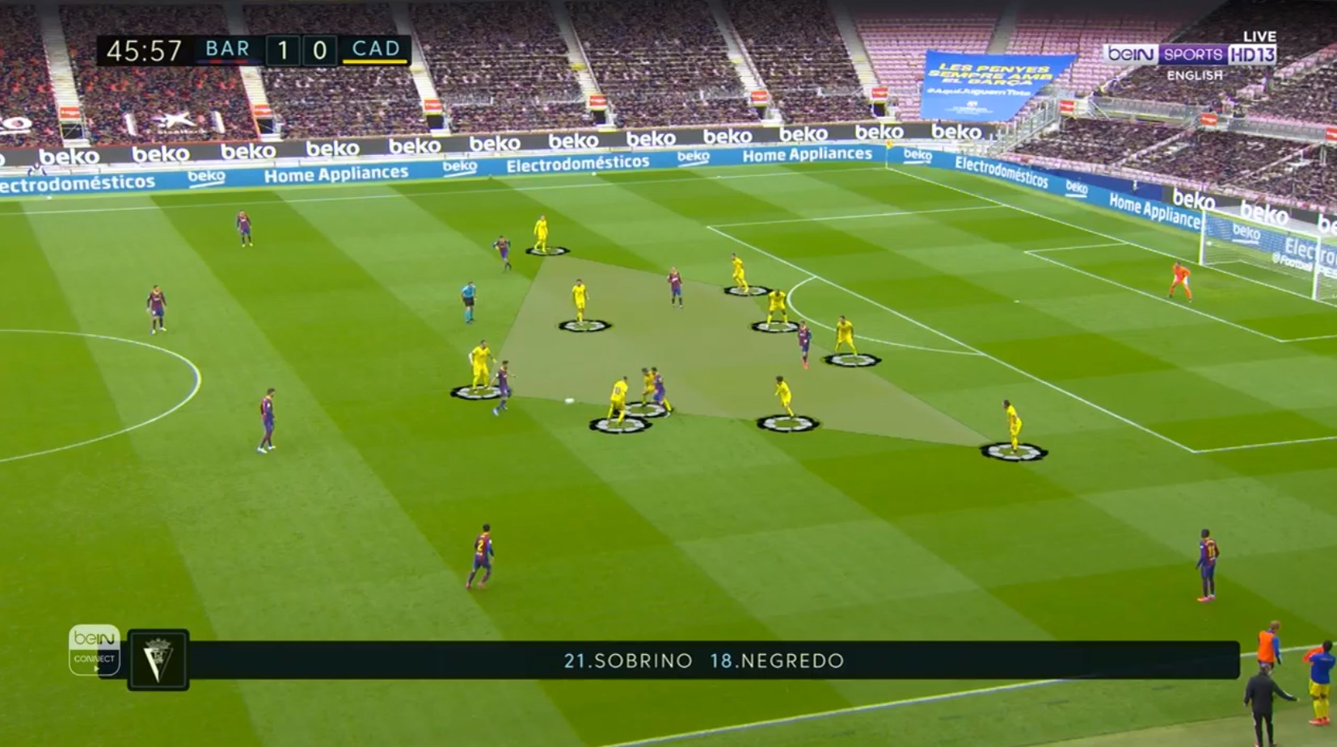
Background
The popularity of football
How the data can be used in football
What data should be collected
Background
Objective
Method
Results
Conclusions

Slide 3
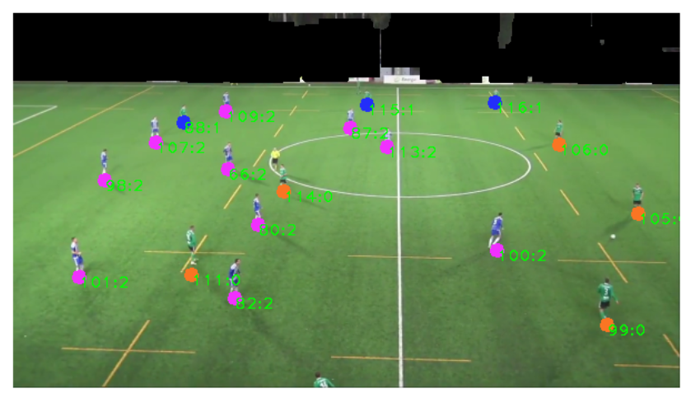
Background
Background
Objective
Method
Results
Conclusions

Slide 4
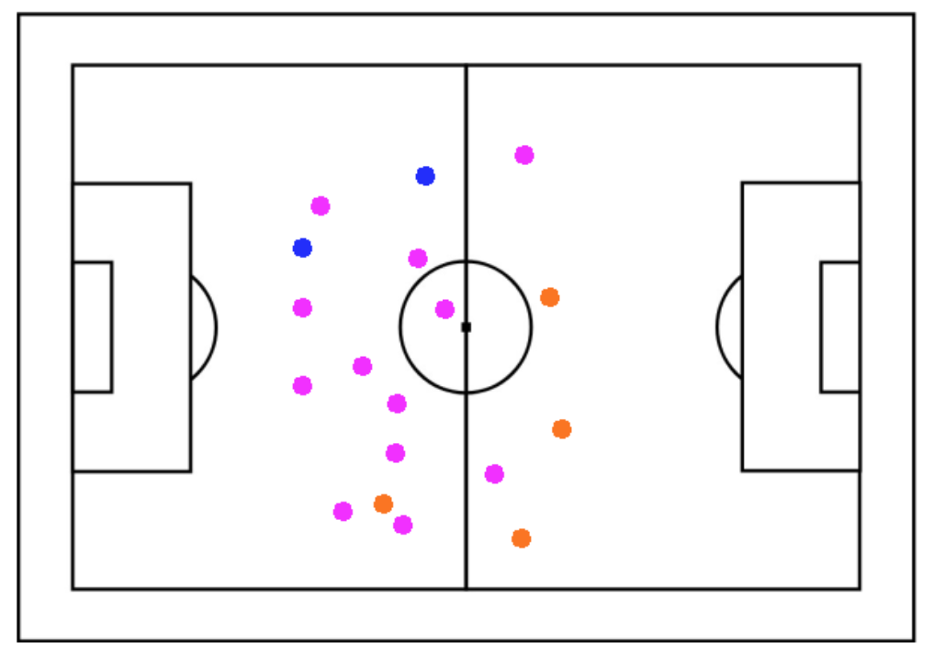
Background
Background
Objective
Method
Results
Conclusions

Slide 5
Related works
Field Registration:
Manual calibration [Ghanem2012]
Automatic calibration [Sharma2018, Chen2019]
Player Detection:
HOG detector [Santosh2019]
CNN multibox detector [Ramanathan2016]
Complete systems:
Multi-camera tracking [Baysal2015]
Background
Objective
Method
Results
Conclusions

Slide 6
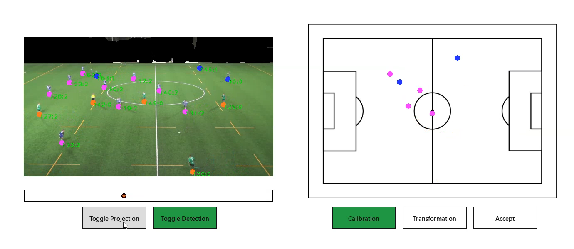
Objective
Research affordable way of collecting data
Use footage from single camera
Limitations of input video
Background
Objective
Method
Results
Conclusions

Slide 7
Method
Background
Objective
Method
Results
Conclusions
Player detection with YOLOv3 detector
Semi automatic camera calibration
Camera angle modelling using optical flow
Homography interpolation
Player classification into teams

Slide 8
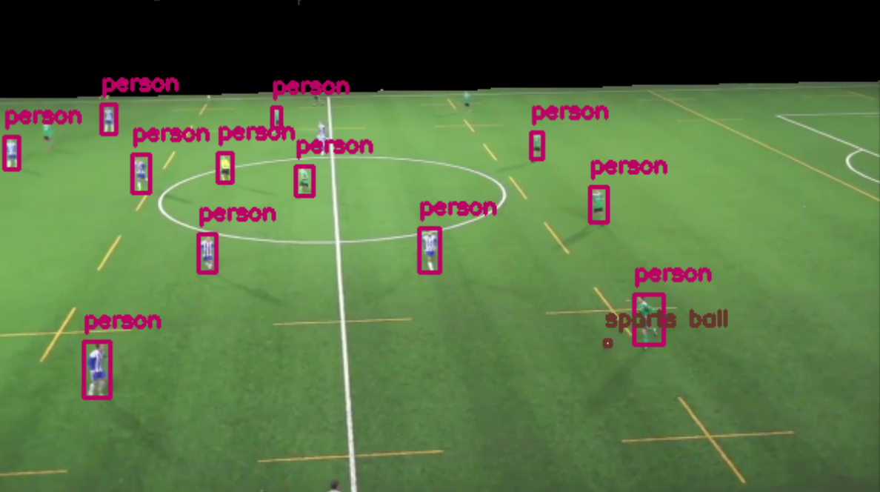
Method: Player detection
Detection performed by YOLOv3 detector
Detection limited to football bitch using color segmentation
Background
Objective
Method
Results
Conclusions

Slide 9
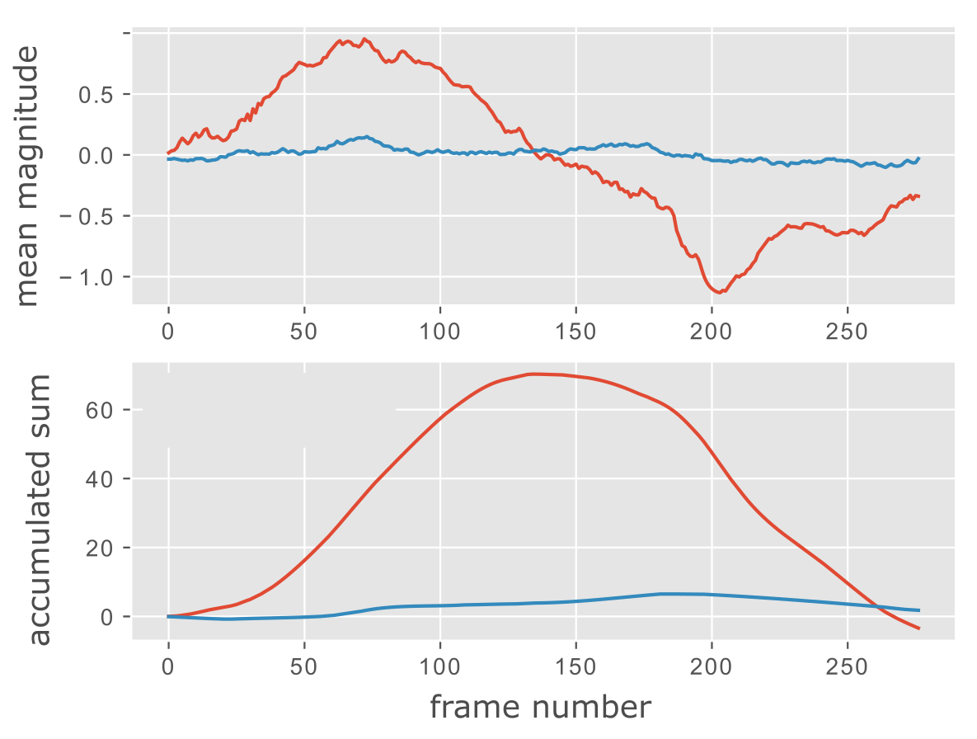
Method: Camera angle modelling
Approximation of horizontal panning with Optical Flow
Background
Objective
Method
Results
Conclusions

Slide 10
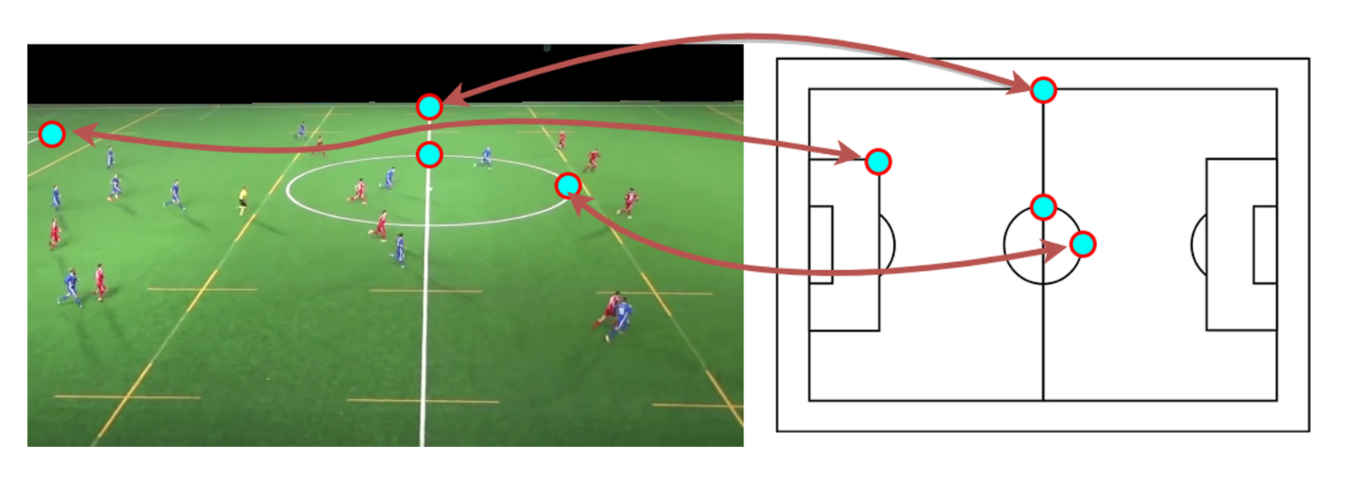
Method: Camera Calibration
Calibration of a few frames
Interpolation based on camera angle model
Background
Objective
Method
Results
Conclusions

Slide 11
Method: Player classification
Hue and Saturation histograms
Division into upper and lower halves (t-shirt and shorts)
Classes are defined using clustering
Background
Objective
Method
Results
Conclusions

Slide 12
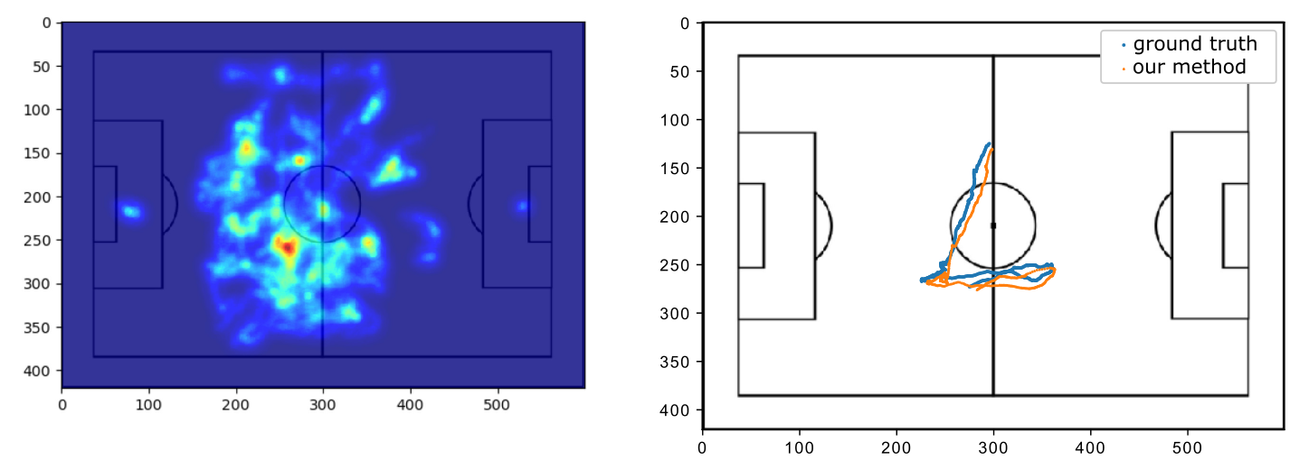
Results
Heatmaps comparison
Player trajectory comparison
Background
Objective
Method
Results
Conclusions

Slide 13
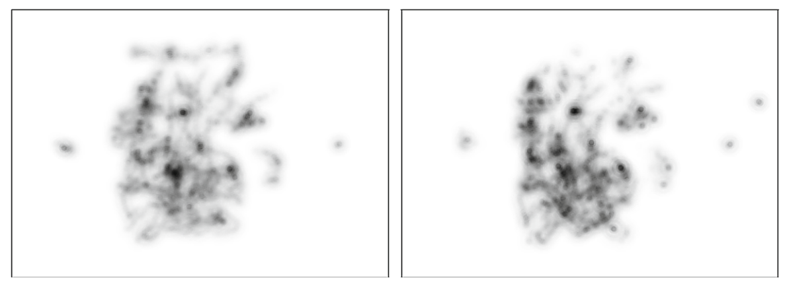
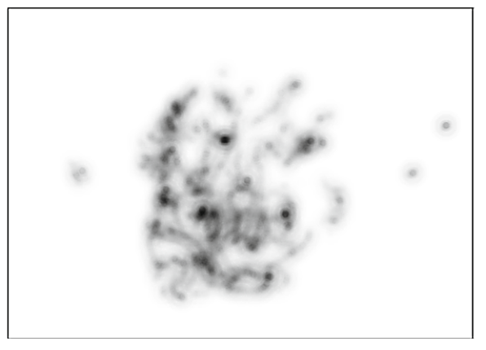
Results: Heatmaps
Compared using SSIM
Background
Objective
Method
Results
Conclusions
Ground truth
3 key-frames
2 key-frames

Slide 14
Results: Heatmaps
Background
Objective
Method
Results
Conclusions
Calibration method | Video material
 | 1 | 2 | 3
3 key-frames | 0.875 | 0.871 | 0.831
2 key-frames | 0.857 | 0.858 | 0.834
Simple interpolation (reduced time span) | 0.866 | 0.852 | 0.904
SSIM values for heatmaps generated using different calibration methods

Slide 15
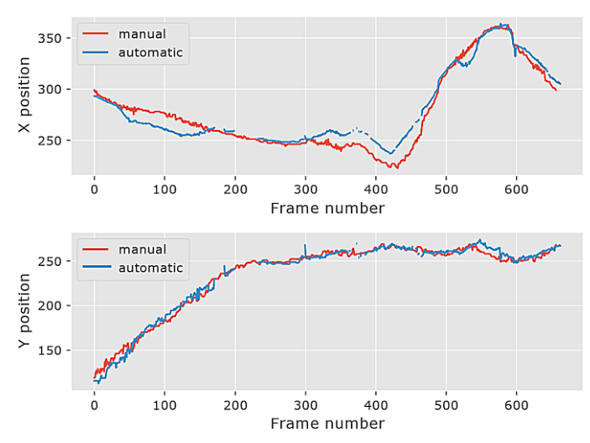
Results: Player paths
Compared to ground truth using mean distance
Background
Objective
Method
Results
Conclusions

Slide 16
Results: Player paths
Background
Objective
Method
Results
Conclusions
Calibration method | Video material
 | 1 | 2 | 3
3 key-frames | 9.694 | 9.816 | 27.302
2 key-frames | 9.908 | 13.399 | 28.444
Simple interpolation (reduced time span) | 18.063 | 10.562 | 9.438
Mean distances (in pixels) between paths travelled by selected player and
different calibration methods

Slide 17
Conclusions
Heatmaps and trajectories can be generated using collected data
Collecting players movement from single camera
Small tolerance for fast camera view changes
Football pitch has to be green (and non pitch objects in different color)
Proposed method works in offline mode (because of Optical Flow)
Input footage has to be continuous, single shot
Future work:
Automatic camera calibration [Chen2019, Homayounfar2017]
Automatic scene detection [Wang2005]
Background
Objective
Method
Results
Conclusions

Slide 18
References
[Baysal2015]: Baysal, S., & Duygulu, P. (2015). Sentioscope: a soccer player tracking system using model field particles. IEEE Transactions on Circuits and Systems for Video Technology, 26(7), 1350-1362.
[Santosh2019]: Santhosh, P., Kaarthick, B.: An automated player detection and tracking in bas-
ketball game. Comput. Mater. Continua 58(3), 625–639 (2019)
[Ghanem201]: Ghanem, B., Zhang, T., Ahuja, N.: Robust video registration applied to field-sports
video analysis. In: IEEE International Conference on Acoustics, Speech, and Signal Processing (ICASSP), vol. 2. Citeseer (2012)
[Ramanathan2016]: Ramanathan, V., Huang, J., Abu-El-Haija, S., Gorban, A., Murphy, K., Fei-Fei, L.: Detecting events and key actors in multi-person videos. In: Proceedings of the IEEE Conference on Computer Vision and Pattern Recognition, pp. 3043–3053 (2016)
Background
Objective
Method
Results
Conclusions

Slide 19
References
[Chen2019]: Chen, J., Little, J.J.: Sports camera calibration via synthetic data. In: Proceedings of the IEEE/CVF Conference on Computer Vision and Pattern Recognition Workshops (2019)
[Homayounfar2017]: Homayounfar, N., Fidler, S., Urtasun, R.: Sports field localization via deep structured models. In: Procedings of the IEEE Conference on Computer Vision and Pattern Recognition, pp. 5212–5220 (2017)
[Wang2005]: Wang, J., Chng, E., Xu, C.: Soccer replay detection using scene transition structure analysis. In: Proceedings (ICASSP 2005). IEEE International Conference on Acoustics, Speech, and Signal Processing, 2005, vol. 2, pp. ii/433–ii/436 (2005).
Background
Objective
Method
Results
Conclusions

